Slide 1


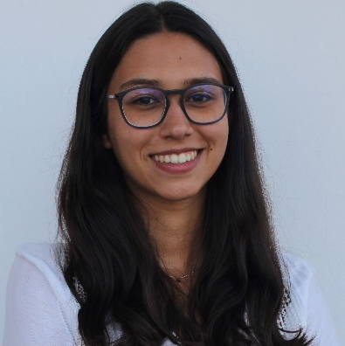
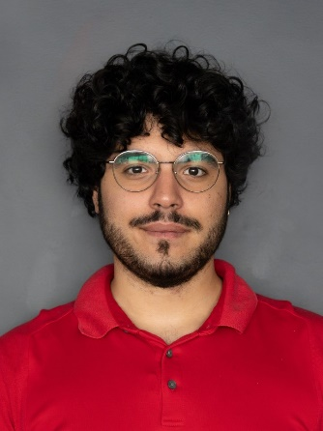
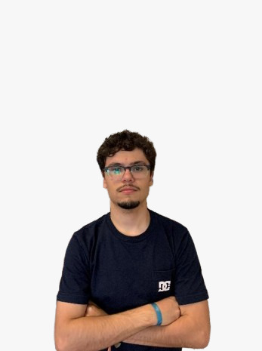
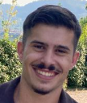
Autonomous Intelligent Systems 2023/2024: CNC Project Presentation
Master on Industrial Electronics and Computers Engineering
Specialization on Control, Automation and Robotics
Group 4: RIMA Robotics
José Vicente Pereira , PG53988
Matheus Costa, PG50649
Sérgio Fernandes, A95710
Susana Guimarães, PG54245
Professors:
Estela Bicho Erlhagen, estela.bicho@dei.uminho.pt
Sergio Monteiro, sergio@dei.uminho.pt
Luís Louro, louro@dei.uminho.pt
Dept. of Industrial Electronics
University of Minho

Slide 2


Logotipo:

Slide 3
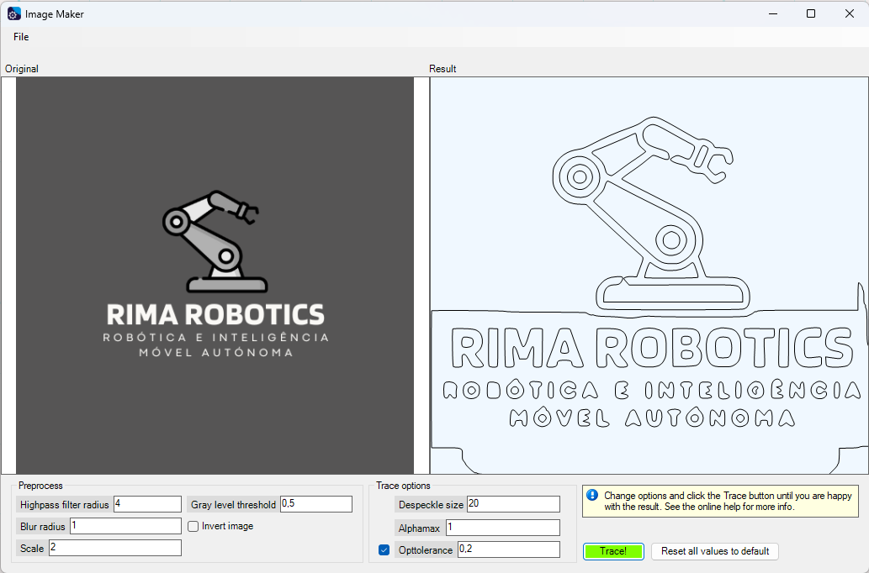
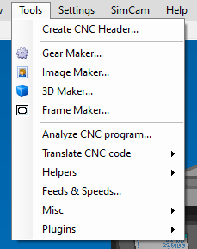
CNC Simulation:
Image Maker

Slide 4
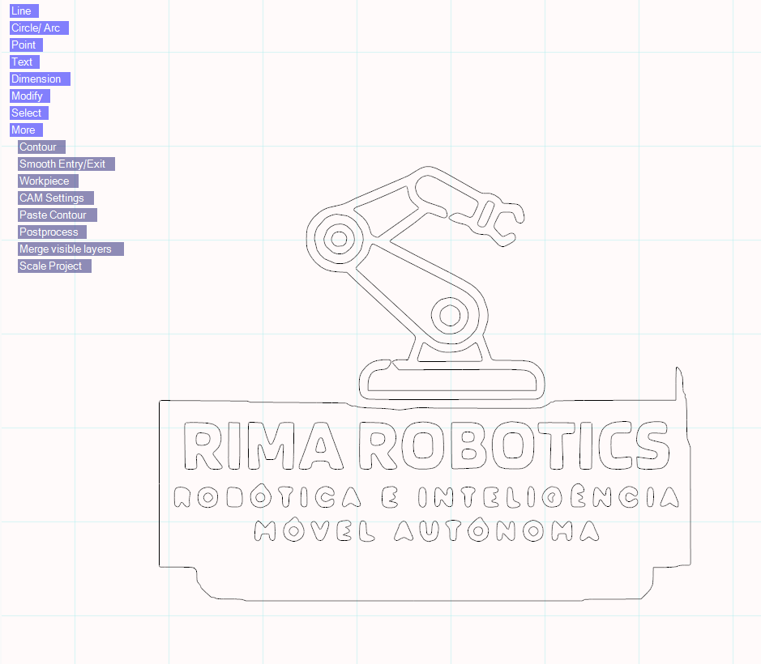
CNC Simulation:
SimCam Export

Slide 5
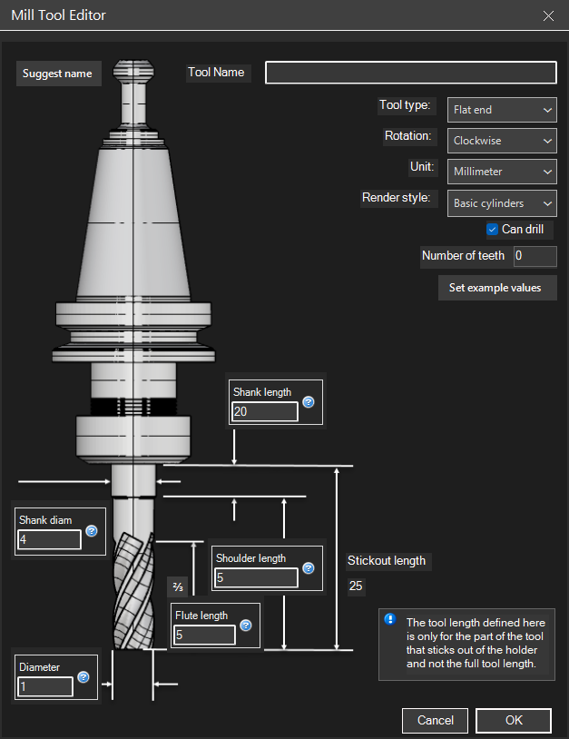
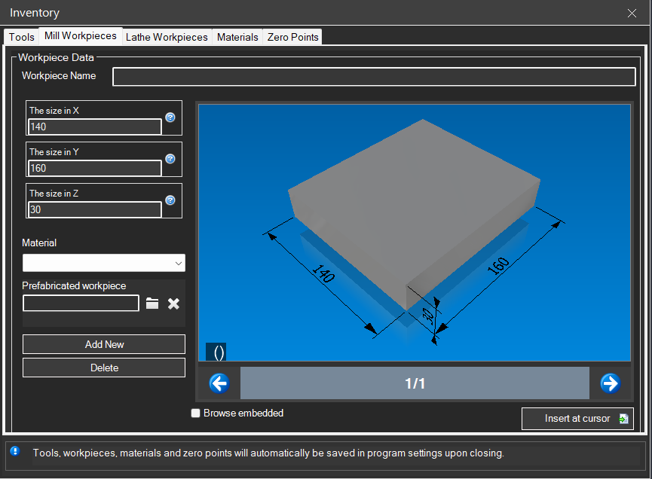
CNC Simulation:
Workpiece and Drill

Slide 6
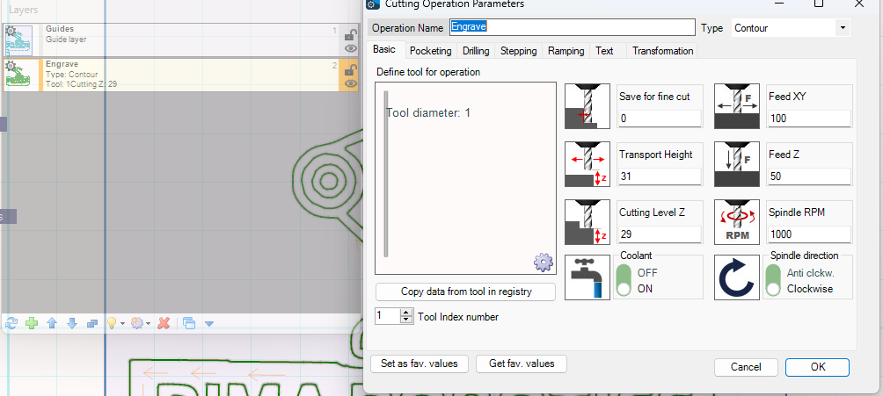
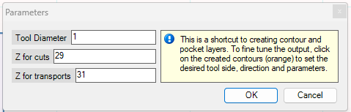
CNC Simulation:
Engrave Configuration

Slide 7
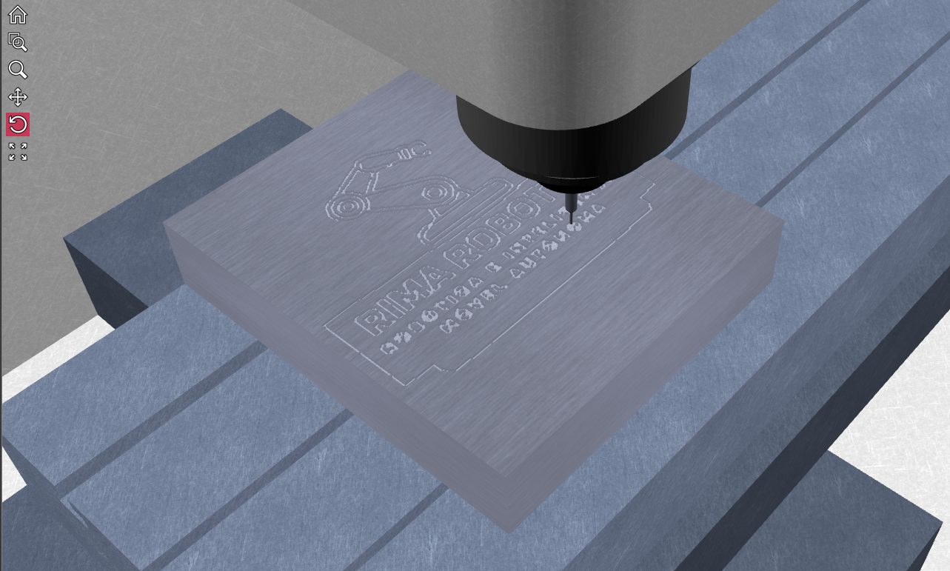
CNC Simulation:
Final Result

Slide 8
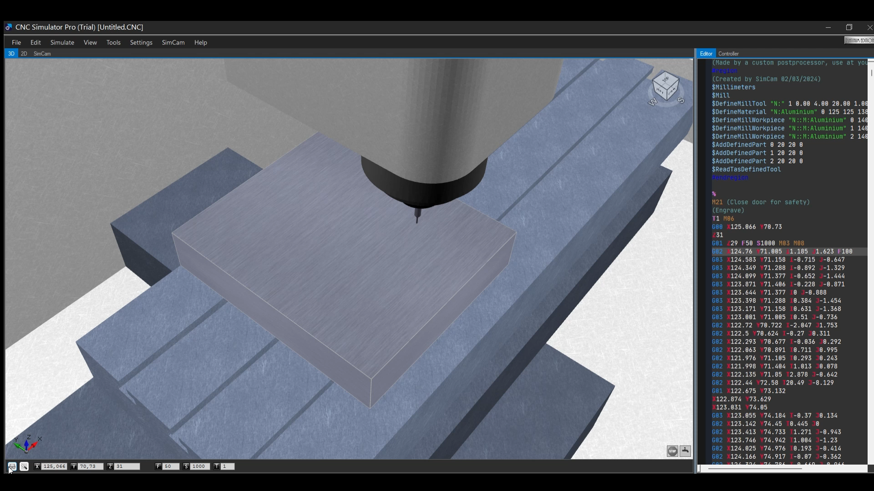
CNC Simulation:
Simulation Video

